Slide 1
Othello Playing Agent
CSC361

Slide 2
Contents
1
Evaluation function
2
Weighted sum
3
Performance

Slide 3
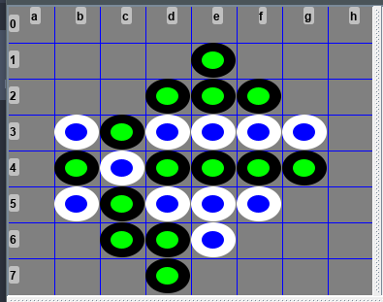
Evaluation function: Corners

Slide 4
Evaluation function: Score
White Score = 11
Black Score = 14

Slide 5
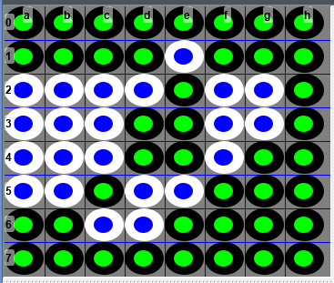
Evaluation function: Winner
Winner is black

Slide 6
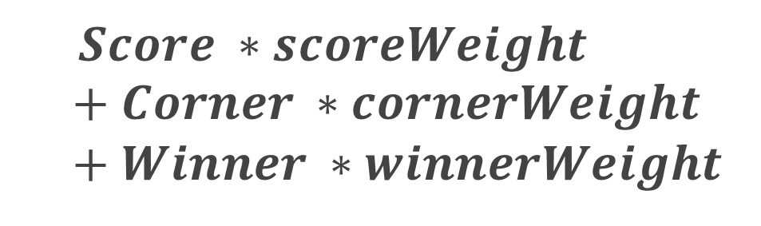
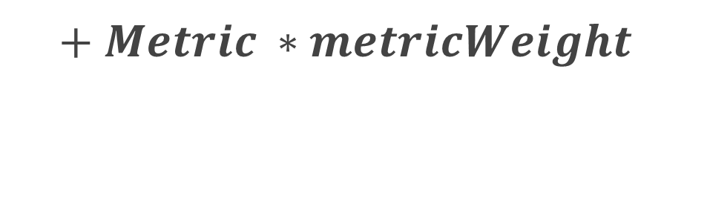
Weighted sum
$Score ∗scoreWeight +Corner ∗cornerWeight+Winner ∗winnerWeight$
$$+ Metric ∗metricWeight$$

Slide 7
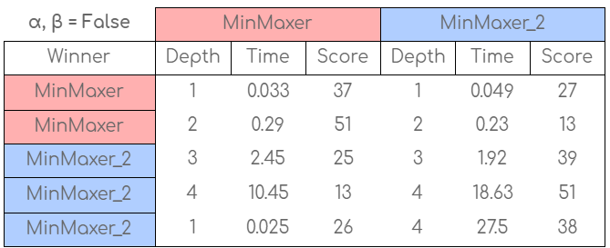
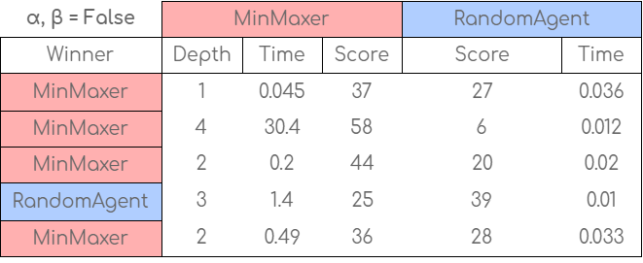
Results (α, β = False)

Slide 8
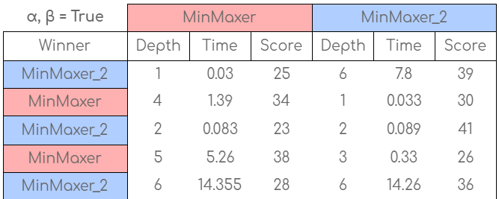
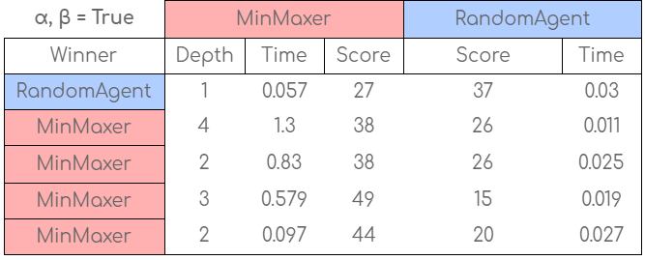
Results (α, β = True)

Slide 9
Thank you
Mohand Al-Rasheed
Abdulaziz Al-Jamhour, Abdulmalik Al-Argani

